Slide 1
AuraSky
The NFT Marketplace - Group 05
Nguyen Duc Manh - 20125012
Duong Tuan Dung - 20125025
Pham Viet Hoang - 20125031
Le Nguyen Quang Minh - 20125038

Slide 2
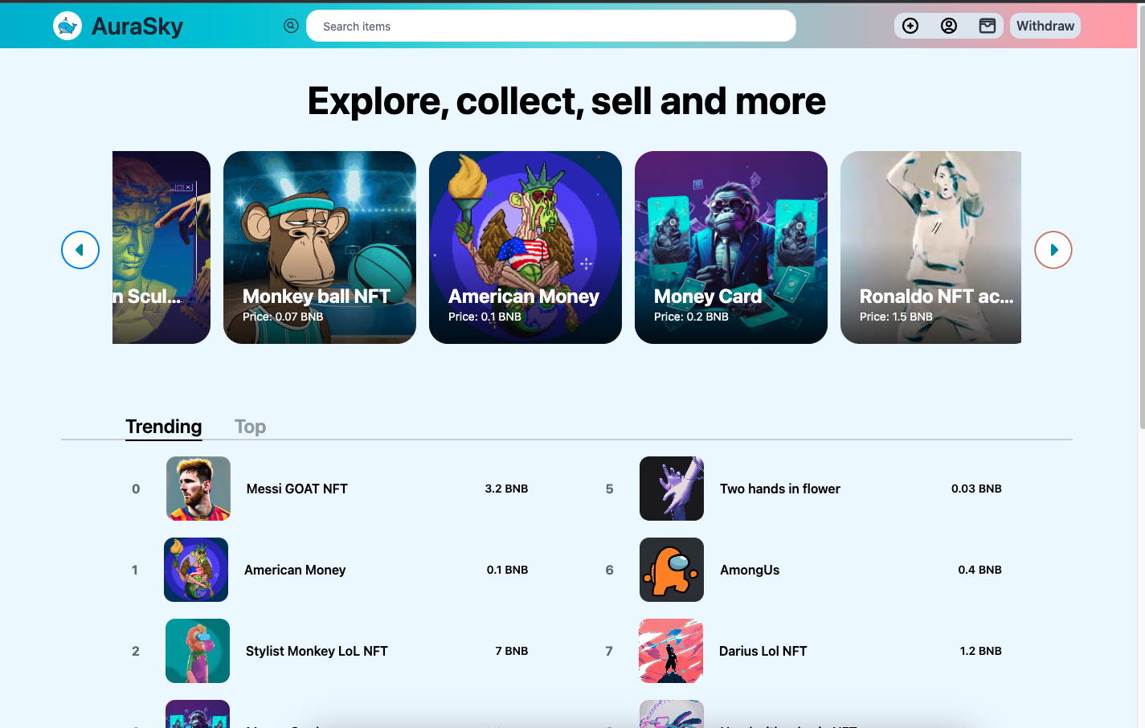
Project overview
& management
Product Position Statement
For | Anyone
Who | is interested in crypto and NFTs
The (product name) | is a web
That | creates a place where you can buy and sell NFTs like traditional markets.
Inspire | opensea.io
Our product | using a smart contract to handle NFTs and selling/buying NFTs

Slide 3





Project overview
& management
Stakeholders
Users
Angel Investors
Dev Team
Customers
Admin
Fundraising
Department
Legal
Department
Project Manager
Pham Viet Hoang
Front-end
Duong Tuan Dung
AuraSky FAMILY
Le Nguyen Quang Minh
Tester
Nguyen Duc Manh
Designer
Blockchain & Back-end

Slide 4
Product Features
Software
Requirements
Feature | Description | Priority
Create and trade NFTs | Users can create their own NFTs and sell them on AuraSky Marketplace. Users can buy NFTs from other users or NFT creators with their crypto. If users own an NFT, they can sell or trade with other users at their desired price. | High
Crypto wallets | Users connect their crypto wallet to AuraSky to keep their assets from trading NFTs on the marketplace. For security purposes, crypto wallets are also used for storing users' personal information on AuraSky by preventing hackers from stealing data from a centralized server. | High
Front-end | By accessing AuraSky website, users can view multiple types of NFTs, NFT collections, and collectibles on AuraSky Marketplace. Hot NFTs and most active collectibles ranking. Searching NFTs, collections, and collectibles are supported for users on AuraSky. | High
Back-end | An pseudo server used to store NFTs' data that is just created but never traded. | Medium

Slide 5
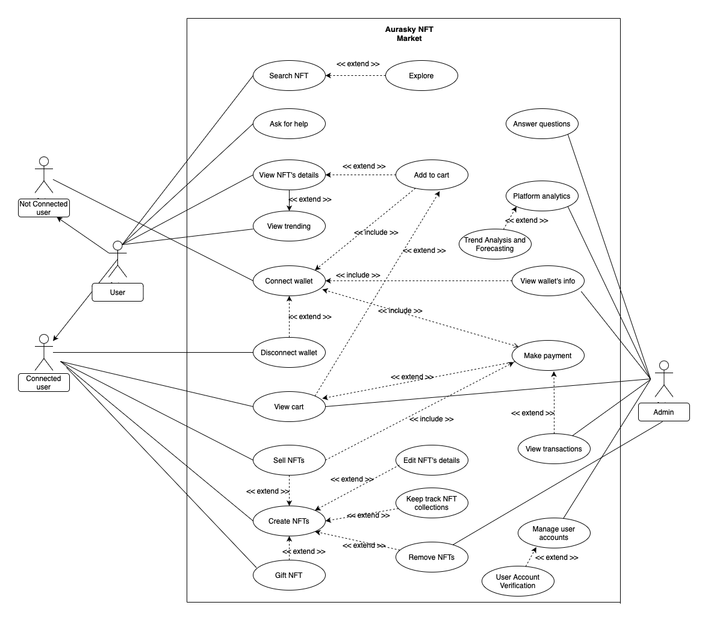
Use-case model

Slide 6
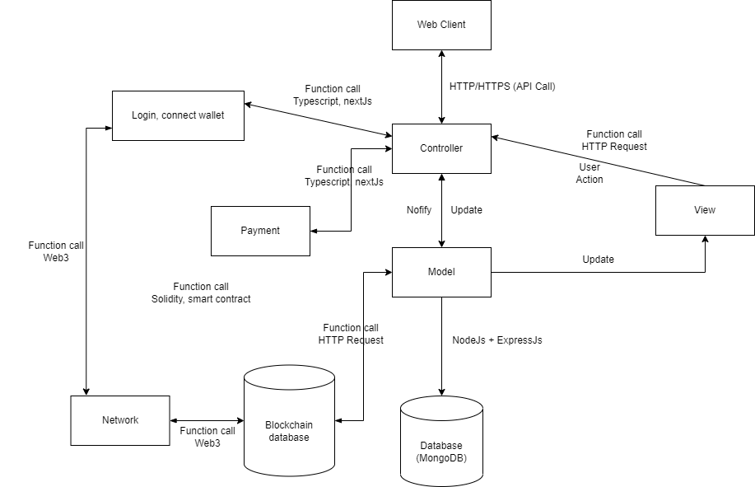
Analyst and
Design
Logical View

Slide 7
Analyst and
Design
Tech Stack
Component | Techs
Web Application (Front-end) | Next.js, Tailwind CSS, Vercel (deployment)
Web Server (Back-end) | Express.js, Vercel (deployment)
Database | MongoDB, Firebase
Blockchain | Solidity, Truffle (deployment)

Slide 8
Software Testing - Features
Feature Name | Description
Connect metamask wallet | Test connecting wallet
View profile | Test viewing profile
View NFTs details | Test viewing NFTs details
Create NFT | Test creating NFT
Sell NFT | Test selling NFT
Buy NFT | Test buying profile
Withdraw money | Test withdrawing money
Search NFTs | Test searching NFT
Feature | Test cases | Failed | Passed
Connect Metamask wallet | 4 | 1 | 3
View profile | 4 | 0 | 4
View NFT details | 2 | 0 | 2
Create NFT | 5 | 3 | 2
Sell NFT | 3 | 1 | 2
Buy NFT | 3 | 0 | 3
Withdraw money | 4 | 0 | 4
Search Engine | 4 | 0 | 4

Slide 9
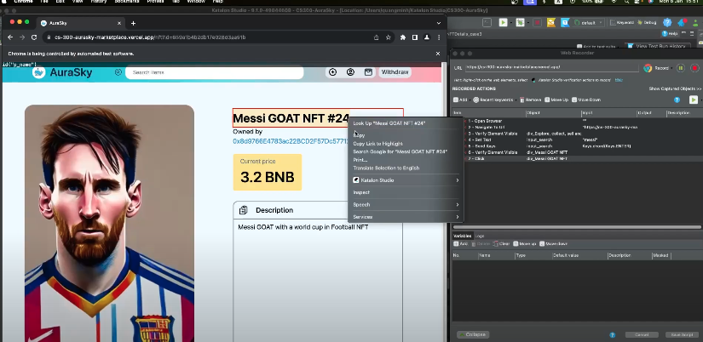
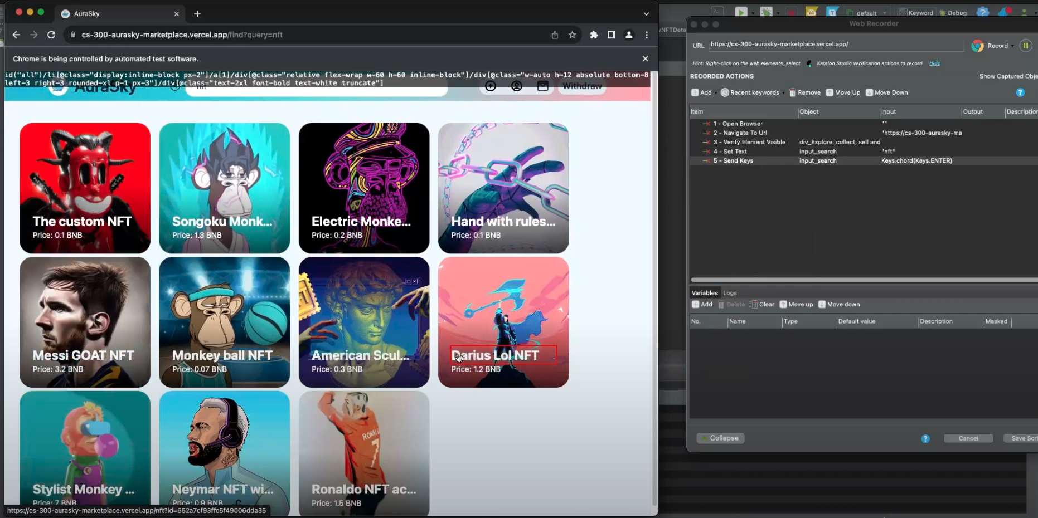
Software Testing Automation Test

Slide 10
PROJECT DEMO
&
THANKS FOR
LISTENING!

